Slide 1
Lecture 9
Systematic Debugging
(Adjusted/Modified By Alvarado Leonel and Connor White)

Slide 2
What are we going to cover today?
Types of errors
Catching errors
The debugging process
The use of the debugger in the IDE

Slide 3
Errors in coding
EVERYONE
Everyone makes errors when coding
While better programmers do tend to make fewer errors, they still make them
Studies have shown that better programmers not only make fewer errors, but (even more significantly) they are able to find and fix errors more quickly
So, we are going to focus on the process of finding and fixing errors

Slide 4
Types of errors: Syntax Errors
Using incorrect syntax
Usually the interpreter/IDE will catch this
Most times, the code will not run at all
Relatively easy to find and fix most of these
Examples:
whil x > 3: # misspelled while if x = 2: # used assignment (=) instead of == def dosomething(x): ... dosomething() # forgot parameter

Slide 5
Types of errors: Run-Time Errors
Errors that occur at run-time
Often referred to as an “exception”
Might not be predictable ahead of time
Because Python is interpreted, some syntax errors won’t show up until run-time
Sometimes you can write a program that uses up too much memory
Sometimes you can write a program that makes too many nested function calls
Happens with recursion – when a function can call itself

Slide 6
Run-time error examples
answer = int(input('Enter a number: ')) # fails if the user doesn't enter an integer a = my_list[20] # fails if the list has fewer than 21 elements c = a / b # fails if b is zero L = [1] while True: L += [1] # fails eventually, since list L grows forever (uses too much memory)

Slide 7
Types of errors: Logic Errors
A mistake in how the code works
Code “runs,” but produces the wrong output
Or, code fails on cases that should work (though the error is a run-time error, the fundamental problem is a logic problem)
The toughest type of error to deal with
The error often shows up far from the place where the mistake actually was
These are the sources of “bugs” in the code
Examples:
myanswer = 4 # variable should have been my_answer if x > 2: # should have been x >= 2 a = 3 b = 4 # should have been indented

Slide 8
Logic errors
Some logic errors are due to typos
Forgetting to indent
Misspelling a variable
Typing the wrong variable name
Some logic errors are due to misunderstandings
The programmer might have thought an approach would work, but it doesn’t
The debugging process will handle these

Slide 9
Handling run-time errors
While specific run-time errors might not be predictable (e.g. based on input data), we can sometimes still find code that is prone to breaking
There is a Python structure for dealing with such errors: the try-except statement
Basic idea: try running code, if there is a run-time error, then (instead of the program crashing) the exception is handled
Offers a chance to (sometimes) fix the problem that caused the error
e.g. ask a user for a different input
Offers a chance to exit “nicely” otherwise
e.g. print out some information about the current state

Slide 10
The try-except statement
Format of the statement:
try: <code to try to run> except <exception_type>: <code to run if there's an exception>
We start with the keyword “try”, followed by a colon

Slide 11
The try-except statement
Format of the statement:
try: <code to try to run> except <exception_type>: <code to run if there's an exception>
We indent all of the code that we want to try to run
If there is NOT an exception (run-time error), then after this code completes, it skips the remainder of the try-except block

Slide 12
The try-except statement
Format of the statement:
try: <code to try to run> except <exception_type>: <code to run if there's an exception>
Next is the except statement

Slide 13
The try-except statement
Format of the statement:
try: <code to try to run> except <exception_type>: <code to run if there's an exception>
That is followed by an OPTIONAL exception type
More about this in a few slides

Slide 14
The try-except statement
Format of the statement:
try: <code to try to run> except <exception_type>: <code to run if there's an exception>
There is a colon and indentation for the next section of code

Slide 15
The try-except statement
Format of the statement:
try: <code to try to run> except <exception_type>: <code to run if there's an exception>
And finally there is code to run if you encounter an exception of the given type

Slide 16
Exception types
There are more than just these, and more can be defined, but these are some common ones:
TypeError – trying to perform an operation on the wrong type of variable (adding int to str)
IndexError – trying to access an element out of range of a list
ZeroDivisionError – error when trying to divide by zero
NameError – trying to access a variable that does not exist

Slide 17
Example – divide by zero error
a = int(input("Enter a numerator: ")) b = int(input("Enter a denominator: ")) try: c = a / b except ZeroDivisionError: print("You can't divide by 0!") b = int(input("Enter an different denominator: ")) c = a / b # We could have an error here, again! print(c)

Slide 18
Example – error type not specified
try: L = [1] while True: L += [1] except: # Notice: no type given, ALL exceptions will be handled here print("Memory limit exceeded! Quitting.")

Slide 19
Catching errors
It is good practice to try to catch errors with try-except statements
Sometimes you can recover and continue
Other times, you might be able to have more information about what went wrong
But, these don’t really address handling bugs

Slide 20

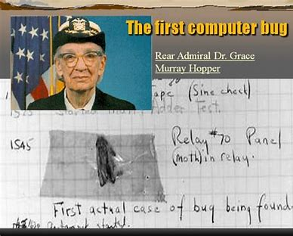
Bugs
The term goes back to Thomas Edison
Working on an improvement to the telegraph, fixed a problem with something he called a “bug trap”
Continued to use the term to refer to problems he encountered
In computing, there’s a well known story
One of the earliest computers, the Mark II, used mechanical relays to create and break connections between wires
In 1947, the computer was not working properly
Grace Hopper found that the problem was a moth caught in a relay; it was the first real computer “bug”
Bug is the common term used in computing for “a problem in a program”

Slide 21
Debugging process – Inexperienced programmers
Find something that doesn’t work.
Change something randomly
No
Did that seem to fix it?
Yes
Success!

Slide 22
A better debugging process
Find a repeatable problem
A test case that reliably gives the wrong answer
Isolate location in code where issue is arising
Run code to find point at which things seem to go wrong
Examine code to find the specific bug
Try to fix the bug
Test whether it now passes the test case that was causing trouble
Check to make sure nothing else broke
Consider whether there were other places in code likely to have a similar problem

Slide 23
Interactive Debugger
Many IDEs include a debugger
Including Spyder and PyCharm
A debugger does NOT fix your bugs!
Rather, it is a tool that can make it easier for you to debug your code
Debuggers usually let you do two main things:
Control the execution of the code
Examine the values stored in memory in the code
We’ll go over some of the most useful things that are found in most debuggers
There are usually a lot of other tools, more advanced but less frequently needed

Slide 24



Running the debugger
You usually need to run in “debug mode” separately from the “normal” mode
In Spyder, you click on the blue play/pause button
In PyCharm, you click the green spider-looking bug icon
This will start the program, either running it, or getting ready to run
Your code will not run as efficiently, since the executable is created for debugging purposes – extra information is provided, less optimization used

Slide 25







Debugger – execution control tools available
Breakpoints
Mark a line of code as a breakpoint
Code will execute to that point and then stop (pause)
Usually set by clicking in front of the line of code
Creates a red circle right of the line number
Step / Step-over
Executes the next line of code
If there is a function call in that line of code, the function call is made and returns normally before going to the next line of code
Step-into
Executes the next line of code
If there is a function call, the code stops inside that function, at the beginning of the function
Continue / Run
Runs until a break point is encountered

Slide 26
Debugger – Examination Tools available
The Call Stack
Lists the “stack” of functions that have been called
If function A calls B and B calls C, then when in C, your stack will show C on top, then B, then A
In the debugger, type “where”
Variable Explorer / Variable Watch-List
A list of some (sometimes all) of the current variables, and their values
You can usually add/remove variables from the watchlist
For aggregate data, you might have a hierarchy of what is stored there

Slide 27
Using the Debugger
Usually set a breakpoint at a point you think is “OK”, and as close as possible to where you think something is going bad
Run the program to the breakpoint, then step-over until you see that one of the variables has the wrong value
You might see the error as you go through line-by-line, but not always
When you find where the code is “going bad”, start over again, but this time step INTO the line(s) of code where the problem seems to be originating
You should get to a point where you find a single line causing difficulty
This does not mean that that line has a bug - it might be highlighting a bug that occurred elsewhere
But, it should give you an idea of what the problem is, so that you can find it and fix it elsewhere

Slide 28
What if you don’t have a debugger?
Print statements are your friends!
While debugging, you can print out values at any point in the code
Might need to print some explanation so it’s clear exactly where in the code it is printing at each line
By examining the printed values at various points in time, you can see how things are changing in memory, to help identify where the code is going wrong (and exactly what is going wrong)
Notes:
Print the lyrics to your favorite Lizzo song!
https://www.youtube.com/watch?v=vuq-VAiW9kw

Slide 29

What if you don’t have a debugger?
Talk to a duck!
Explain your program line-by-line
Can help you find the differences between what your code is supposed to do and what it actually does
https://en.wikipedia.org/wiki/Rubber_duck_debugging

Slide 30
What if you don’t have a debugger?
You can also use the assert statement
This is a way to perform a sanity check on parts of your code
Used to check for valid input for a function
Used to check for correct output of a function (unit testing)
First make an assertion (a statement that results in Boolean True or False)
If it’s True, the program moves on
If it’s False, Python raises an AssertionError exception and stops the program
This is a tool for debugging, you should comment out or remove all assert statements in the final version of your code!
Notes:
OPTIONAL TOPIC

Slide 31
The assert statement
assert <expression>, <arguments>
We start with the keyword “assert”
Notes:
OPTIONAL TOPIC

Slide 32
The assert statement
assert <expression>, <arguments>
Followed by an expression resulting in Boolean True (or False)
Notes:
OPTIONAL TOPIC

Slide 33
The assert statement
assert <expression>, <arguments>
Ending with an optional argument to display if the expression is False
Notes:
OPTIONAL TOPIC

Slide 34
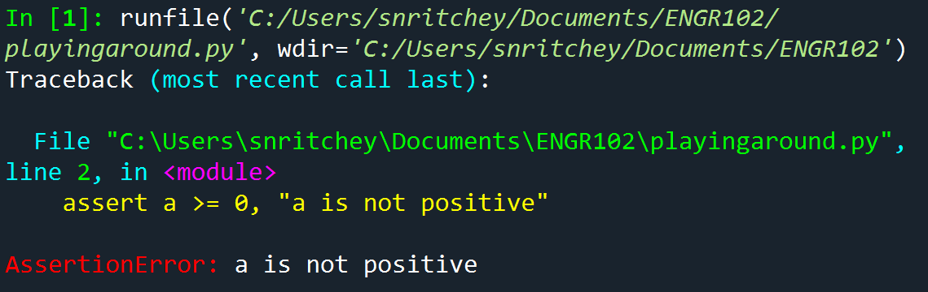
The assert statement
assert <expression>, <arguments>
Example:
a = -1 assert a >= 0, "a is not positive"
Notes:
OPTIONAL TOPIC

Slide 35
Let’s practice debugging!
We’ll now take a program that has a bug, and try to debug it
We’ll illustrate the whole process, and see some of the tools the IDE gives us to work with
You may want to follow along on your own computer, or try on your own later

Slide 36
Remember
Treat debugging as a structured process, NOT random guessing
First ensure the bug is repeatable
Then isolate it as much as possible
Then find and fix it
Then test to make sure
That the bug is fixed
That nothing else was broken
Think about whether the same error might be elsewhere
If so, fix it

Slide 37
Debugging Outside of Programming
The principles of debugging can apply to dealing with other problems
E.g. if something is broken on your car
Or, the thing you designed/built is not working
Identify the problem – make it repeatable
Isolate exactly where it’s coming from
Fix the problem
Test to make sure that the fix is working, and didn’t make something else worse
Think about whether this same problem is likely to crop up elsewhere

